Slide 1
Snake & Tic-Tac-Toe Games
Muhammad Sharjeel (02-235221-016)
Muhammad Umar (02-235221-021)
Abdul Ghaffar (02-235221-009)

Slide 2
Abstract
In this presentation, we will introduce the C++ data structure and algorithms project that includes two classic games: Snake and Tic Tac Toe. These games offer entertaining gameplay and incorporate various functionalities such as high scores, customization options, and different difficulty levels. The project utilizes data structures and algorithms to efficiently manage game logic and player interactions. We will explore the objectives, key features, methodology, and conclusion of this project.

Slide 3
Introduction
Welcome to the presentation on our C++ data structure and algorithms project. Our project focuses on developing two popular games, Snake and Tic Tac Toe, and enhancing them with additional functionalities and customization options. Through this project, we aim to provide an engaging and user-friendly gaming experience. We have utilized data structures and algorithms to efficiently handle game logic, player input, and game state. Let's delve into the details of our project.

Slide 4
Methodology
Our project follows a systematic methodology to implement the Snake and Tic Tac Toe games. We begin by designing the game interfaces and defining the core gameplay mechanics. For the Snake game, we utilize linked lists to represent the snake's body and facilitate smooth movement and growth. In the Tic Tac Toe game, we employ arrays to represent the game board and track player moves. To enhance the games' functionality, we incorporate sorting algorithms for high scores, file handling for records, and the Minimax algorithm for the computer player in Tic Tac Toe. Rigorous testing is conducted to ensure the games are stable and provide an optimal user experience.

Slide 5
Objectives
Develop a Snake game with multiple gameplay options, including high score tracking, difficulty levels, and snake customization.
Implement a Tic Tac Toe game with options to play against the computer or another human, customizable board colors, and varying difficulty levels.
Utilize data structures and algorithms to efficiently manage game logic, player input, and game state.
Create a user-friendly interface that enhances the gaming experience.
Conduct thorough testing to ensure the functionality and stability of the games.

Slide 6
Features
Snake Game:
Multiple gameplay options, including high score tracking and customization.
Snake appearance customization with color selection.
Difficulty levels that affect the speed of the snake.
Individual records tracking for each player.
Tic Tac Toe Game:
Options to play against the computer or another human.
Customizable board colors for a personalized experience.
Difficulty levels that increase the board size and challenge.

Slide 7
FLOW CHARTS
Snake Game
Tic-Tac-Toe

Slide 8
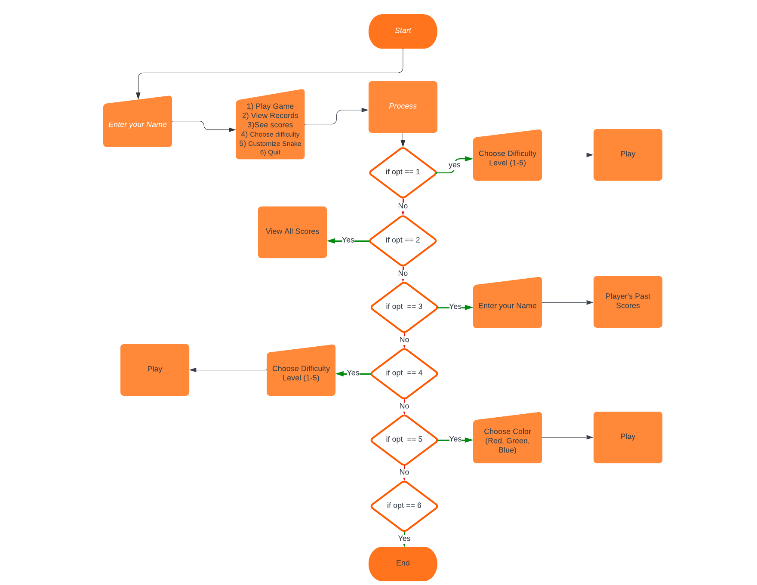
ENGINEERING DESIGN

Slide 9
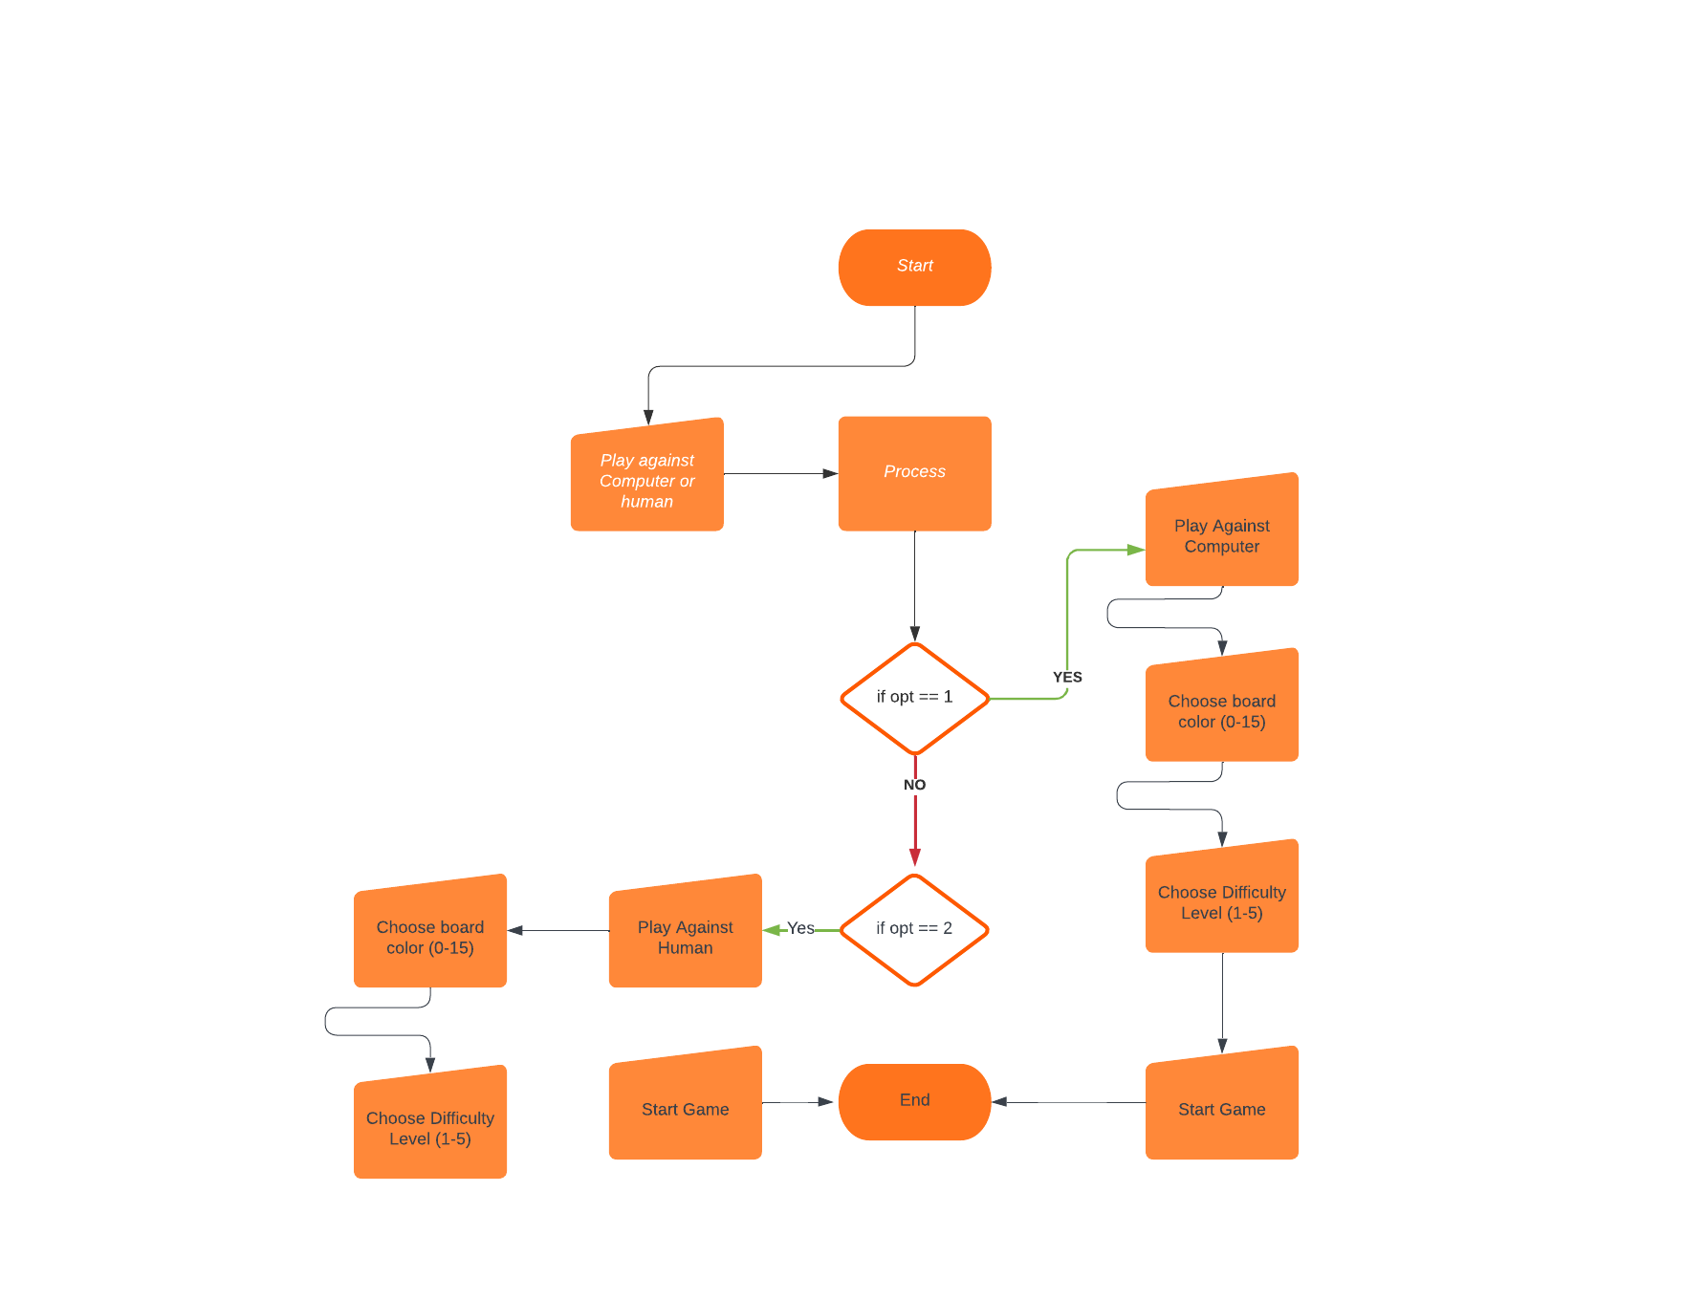
ENGINEERING DESIGN

Slide 10
Conclusion
In conclusion, our C++ data structure and algorithms games project successfully implements two classic games, Snake and Tic Tac Toe, with additional functionalities and customization options. Through the utilization of data structures and algorithms, we have efficiently managed game logic, player input, and game state. The project offers engaging gameplay, customizable features, and a user-friendly interface. The positive reviews from users validate the success of our project in providing an enjoyable gaming experience.

Slide 11
Thank you!

